Slide 1

Culture anglaise et littérature 604-103-MQ
COURSE PLAN ESSENTIALS

Slide 2

BOOKS ARE AVAILABLE AT LA MAISON ANGLAISE – YOU WILL NOT FIND THEM AT THE CÉGEP CO-OP.
Free shipping!
Students get 10% off!

Slide 3




Books and class materials
Indian Horse by Richard Wagamese
(La Maison Anglaise)
Daytripper by Fabio Moon and Gabriel Ba
(La Maison Anglaise)
Photocopies – Entente 604-H207
(billed on Omnivox)

Slide 4



Equipment
Computer
Camera
Headphones with microphone
Office 365 – you can get a license from the cegep
List of passwords – Trust me! There will be a lot of passwords!

Slide 5
PLACEMENT TEST
100
101
102
103

Slide 6
CEGEP English courses
First English course
A3
Second English course
B3
According to placement test
Different programs
Three skills
Same level as A course
Three skills

Slide 7



103 Skills
Speaking
Writing
Reading

Slide 8


Speaking Présenter oralement l’analyse d’une production littéraire ou d’une production à portée sociale ou culturelle en version originale anglaise.
Discussions
Presentations in front of a small group of students
Presentation in front of the entire class

Slide 9

Reading
Short stories
Graphic novel – Daytripper by Fabio Moon & Gabriel Ba
Novel – Indian Horse by Richard Wagamese

Slide 10



Reading Circles
Weekly discussions
Different tasks each week – some will be evaluated
Share information with a partner or in small groups
Submit written work for evaluation before discussions begin

Slide 11

Writing Rédiger l’analyse d’une oeuvre littéraire en version originale anglaise ou d’un sujet à portée sociale ou culturelle.
Development
Practice compositions
Literary Analysis Essay
Content
Readings seen in class
Grammar, Vocabulary, Mechanics
Sentence structure, verb tenses, precise vocabulary

Slide 12



Literary Analysis
involves examining all the parts of a novel, play, short story, or poem—elements such as character, setting, tone, and imagery—and thinking about how the author uses those elements to create certain effects. (sparknotes.com)

Slide 13

Keys to language learning success
Prepare for each class (reading, reading circles, etc.)
Attend class. ☺
Leave all electronic devices in your book bag.
Participate in class discussions and small group discussions.
Review regularly.
Watch TV in English.
Listen to radio or podcasts in English.

Slide 14


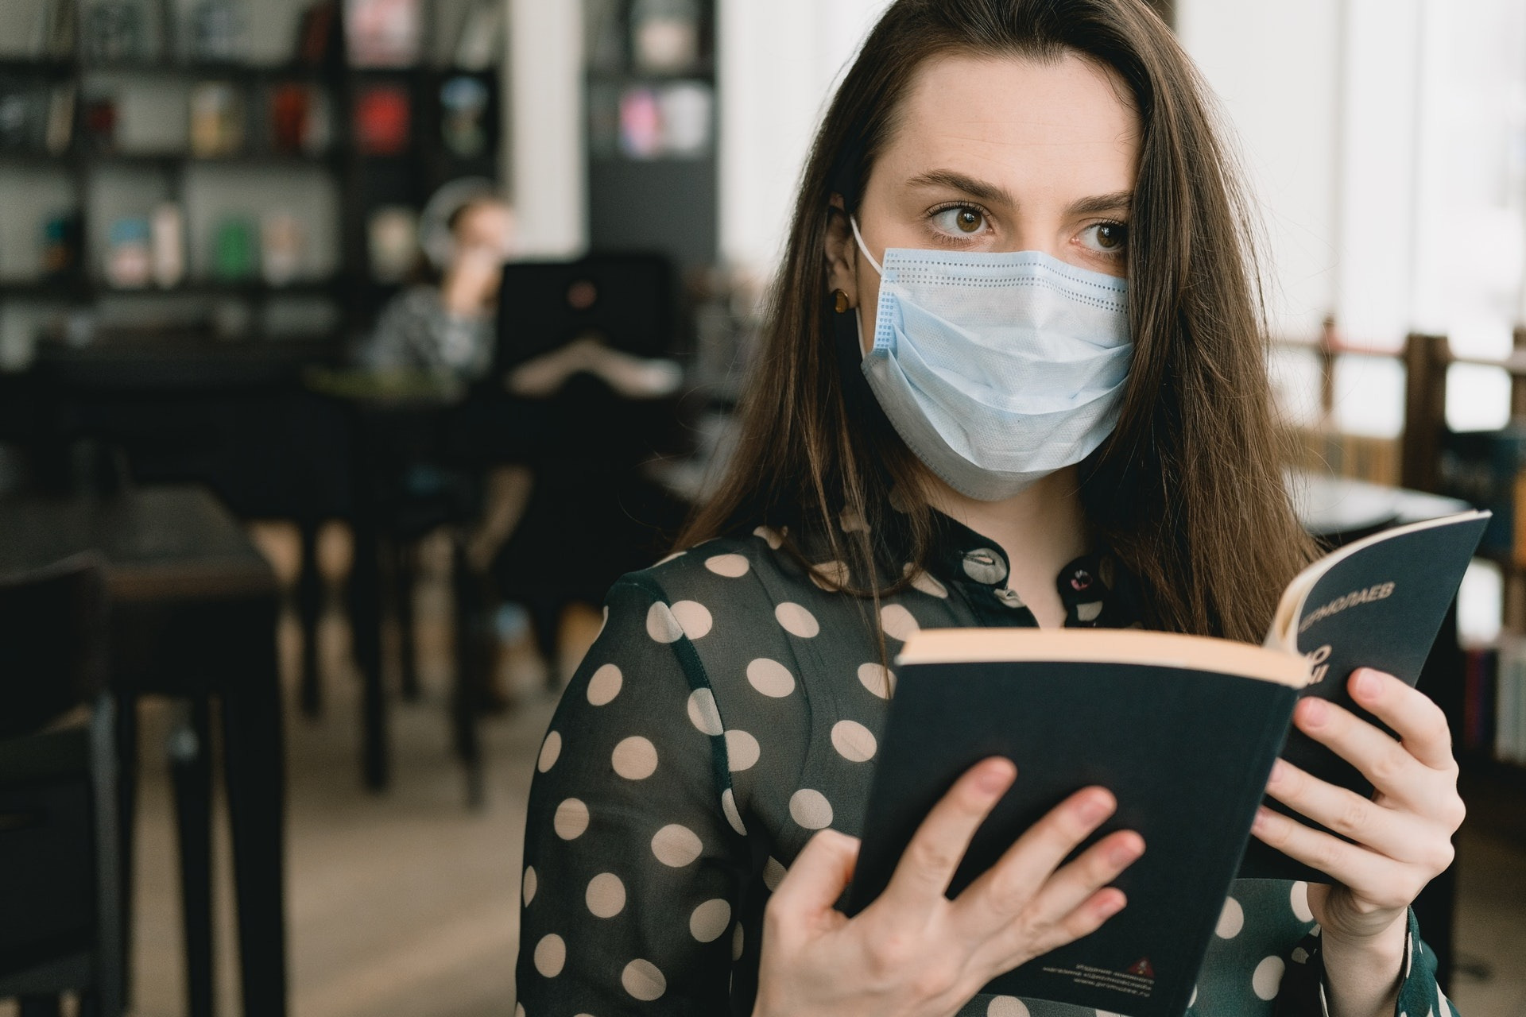
IMPORTANT INFORMATION FOR Winter 2022
Everyone must wear a mask at all time during the class.
Please note that the mask must be worn properly – no exceptions!
Students who refuse to wear a mask or do not wear it properly, below the nose for example, will be asked to leave the class.
Eating in class will not be permitted because masks must be worn at all times.
Be sure to use hand sanitizer when you arrive in class.
Don’t forget to spray the table etc. before leaving.

Slide 15



If you have to isolate …
Be sure to consult the CEGEP website for the most recent information and regulations.
Each week I will put all the documents for that week, including the homework, on LÉA, so you will be responsible for the work you missed and expected to return to class up-to-date and ready to roll!
All assignments are handed in on LÉA (in Remises et Travaux), so you will be expected to hand in your work on time.
Please make an appointment with me when you return, so we can check in and make sure that you are on track! Don’t forget: we can meet on TEAMS ☺

Slide 16



If I have to isolate …
I will send a MIO letting you know what is going on.
In the MIO, I will send a ZOOM link and it will be business as usual … online.
If you are at the cégep, you should go to our classroom (it will be empty) and follow the class on your computer or phone.
There are some computers at the library, you could use. Headphones mandatory!

Slide 17



I look forward to working with you this semester!

